Slide 1




Nelba Barreto
February 2024

Slide 2

Outline
Executive Summary
Introduction
Methodology
Results
Conclusion
Appendix

Slide 3
Executive Summary
Summary of methodologies
Data collection
Data wrangling
Exploratory Data Analysis with Data Visualization
Exploratory Data Analysis with SQL
Interactive Visual Analytics
Interactive Dashboard
Predictive Analysis
Summary of all results
Exploratory Data Analysis Results
Interactive Analytics Demo in Screenshots
Predictive Analysis Results

Slide 4
Introduction
SpaceX advertises Falcon 9 rocket launches on its website with a cost of 62 million dollars, while other providers cost upward of 165 million dollars each. Much of the savings is because SpaceX can reuse the first stage. Therefore, if we can determine if the first stage will land, we can determine the cost of a launch.
Will the first stage land successfully?
?
What variables influence the success or failure of a launch?
?

Slide 5

Section 1

Slide 6
Methodology
Data collection methodology:
Data was obtained from the SpaceX REST API and by scraping the Wikipedia's List of Falcon 9 and Falcon Heavy launches page
Perform data wrangling
Data preparation involved encoding categorical variables into numerical representations, addressing missing data, and applying data transformations for enhanced analysis
Perform exploratory data analysis (EDA) using visualization and SQL
Perform interactive visual analytics using Folium and Plotly Dash
Perform predictive analysis using classification models
After splitting the data into training and test sets, various models were employed to predict the success (1) or failure (0) of the Falcon 9 first stage landing. Optimal hyperparameters were selected using GridSearchCV and evaluation metrics were then applied to assess the performance of each model

Slide 7


Data Collection
https://api.spacexdata.com/v4/launches/past
Additional information was extracted using nested API calls:
Rocket: Booster name
Launchpad: Launch site, longitude, latitude
Payload: Mass, orbit
Cores: Landing outcome, type, flight count, gridfins, reuse, legs, landing pad, block, reuse count, serial
https://en.wikipedia.org/wiki/List_of_Falcon_9_and_Falcon_Heavy_launches
Web scraping was performed to extract an HTML table containing Falcon 9 launch records
01
02
Data Sources
SpaceX REST API
Wikipedia’s List of Falcon 9 and Falcon Heavy launches page

Slide 8



Data Collection – SpaceX API
Make an API request to get SpaceX launch data
Construct the dataset from all the data obtained and create a new DataFrame
Convert JSON result to a DataFrame
Filter the DataFrame to only include Falcon 9 launches
https://github.com/NelbaBarreto/applied-data-science-capstone/blob/main/1_jupyter-labs-spacex-data-collection-api.ipynb
Iterate through the rocket, launchpad, payloads, and core columns of the DataFrame and make an API request to obtain additional information about each one to be stored in separate lists
Deal with missing values in the DataFrame

Slide 9
Data Collection - Scraping
Make an API request to get the Falcon9 Wiki page
Iterate through each th object of the table to extract all column names
https://github.com/NelbaBarreto/applied-data-science-capstone/blob/main/2_jupyter-labs-webscraping.ipynb
Create a BeautifulSoup object from the HTML response
Create a DataFrame by parsing the launch HTML tables
Using the BeautifulSoup object, find the table that contains the launch records

Slide 10
Data Wrangling
https://github.com/NelbaBarreto/applied-data-science-capstone/blob/main/3_labs-jupyter-spacex-Data%20wrangling.ipynb
Perform some Exploratory Data Analysis (EDA) on the dataset
Create a Class column using the Outcome column
Determine the number of launches on each site, the number and occurrence of each orbit, and the number of landing outcomes
Landing Outcomes | Landing Class | Meaning
True ASDS; True RTLS; True Ocean | 1 | Success
None None; False ASDS; False Ocean; None ASDS; False RTLS | 0 | Failure

Slide 11
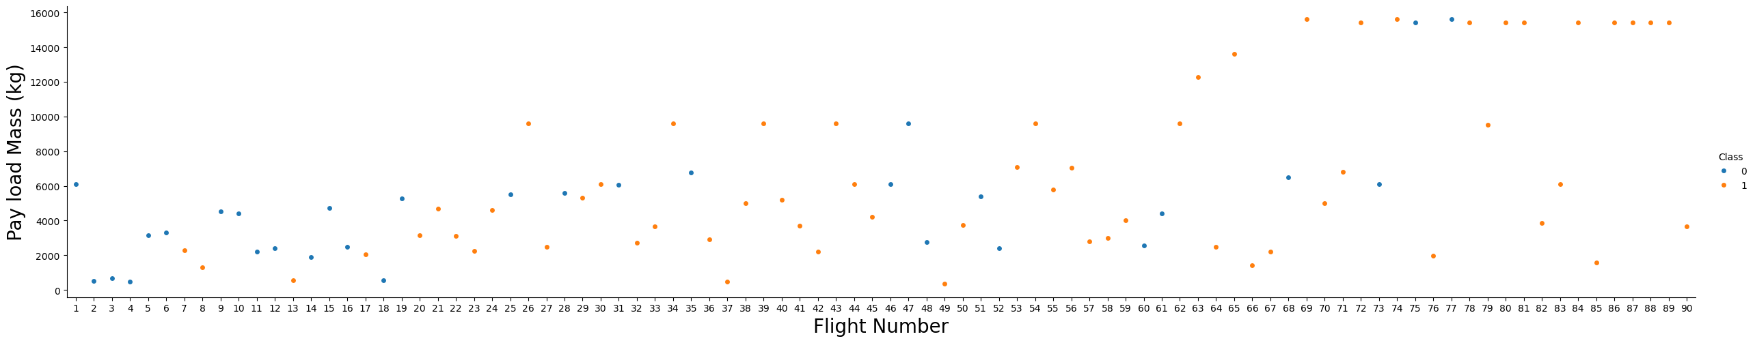
EDA with Data Visualization
Scatter plots were used to examine the relationship between two continuous variables
01
https://github.com/NelbaBarreto/applied-data-science-capstone/blob/main/5_jupyter-labs-eda-dataviz.ipynb
FlightNumber vs PayloadMass

Slide 12
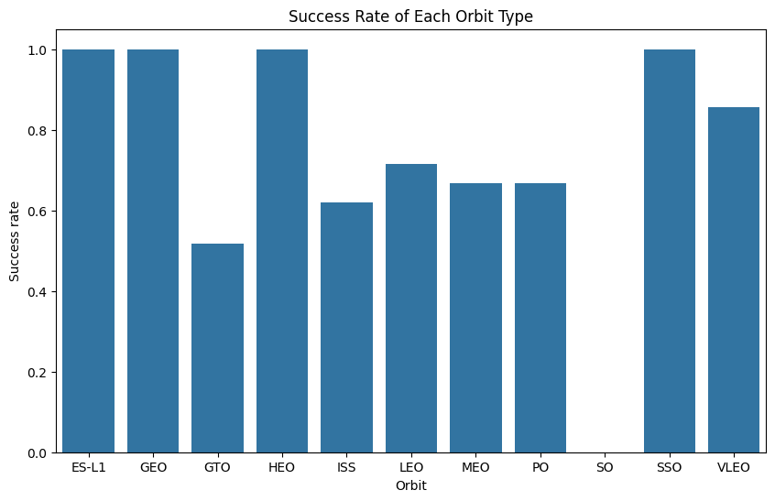
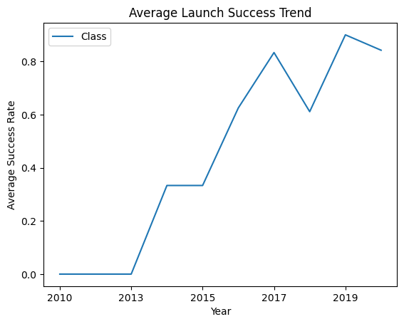
EDA with Data Visualization
02
03
A bar chart was used to make a comparison between categories
A line chart was used to track the average success rate over time
https://github.com/NelbaBarreto/applied-data-science-capstone/blob/main/5_jupyter-labs-eda-dataviz.ipynb
Success Rate of Each Orbit Type
Average Launch Success Trend

Slide 13
EDA with SQL
The following information was obtained through SQL queries:
https://github.com/NelbaBarreto/applied-data-science-capstone/blob/main/4_jupyter-labs-eda-sql-coursera_sqllite.ipynb
The names of the unique launch sites in the space mission | The names of the boosters which have success in drone ship and have payload mass greater than 4000 but less than 6000
5 records where launch sites begin with the string ‘CCA’ | The total number of successful and failure mission outcomes
The total payload mass carried by boosters launched by Nasa (CRS) | The names of the booster_versions which have carried the maximum payload mass
The average payload mass carried by booster version F9 v1.1 | The date when the first successful landing outcome in group pad was achieved
The month names, failure landing_outcomes in drone ship, booster versions and launch_site for the months in year 2015 | The ranking of the count of landing outcomes between the date 2010-06-04 and 2017-03-20, in descending order

Slide 14
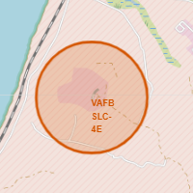
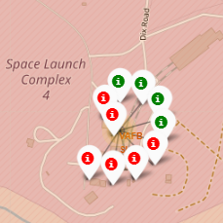
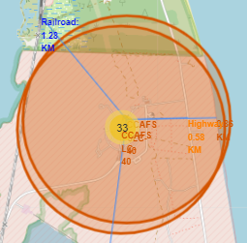
Build an Interactive Map with Folium
Folium was employed to uncover any discernible geographical patterns related to launch sites
Markers were used to add a marker on specific coordinates, representing each launch site and each launch
https://github.com/NelbaBarreto/applied-data-science-capstone/blob/main/6_lab_jupyter_launch_site_location.ipynb
Markers clusters were used to group markers in each launching site
Circles were used to add a highlighted circle area on specific coordinates
Lines were used to show the distances between a launch site to its proximities

Slide 15
Build a Dashboard with Plotly Dash
The dashboard includes the following plots, graphs, and interactive features:
A drop-down menu for selecting launch sites
01
https://github.com/NelbaBarreto/applied-data-science-capstone/blob/main/7_spacex_dash_app.py
A callback function that renders a pie chart, visualizing the counts of launch successes based on the selected launch site from the dropdown
02
A range slider for selecting payload parameters
03
A callback function that renders a scatter plot depicting Payload vs. Launch Outcome, based on the selected payload parameters
04

Slide 16
Predictive Analysis (Classification)
https://github.com/NelbaBarreto/applied-data-science-capstone/blob/main/8_SpaceX_Machine_Learning_Prediction_Part_5.ipynb
Create NumPy array for the target variable
Utilize GridSearchCV to train models for Logistic Regression, Support Vector Machine, Decision Tree Classifier, and K Nearest Neighbors
Standardize the feature data
Calculate the accuracy of each model on the train and test data to identify the most effective method
Split data into training and testing sets

Slide 17
Results
Exploratory data analysis results
Interactive analytics demo in screenshots
Predictive analysis results

Slide 18

Section 2

Slide 19
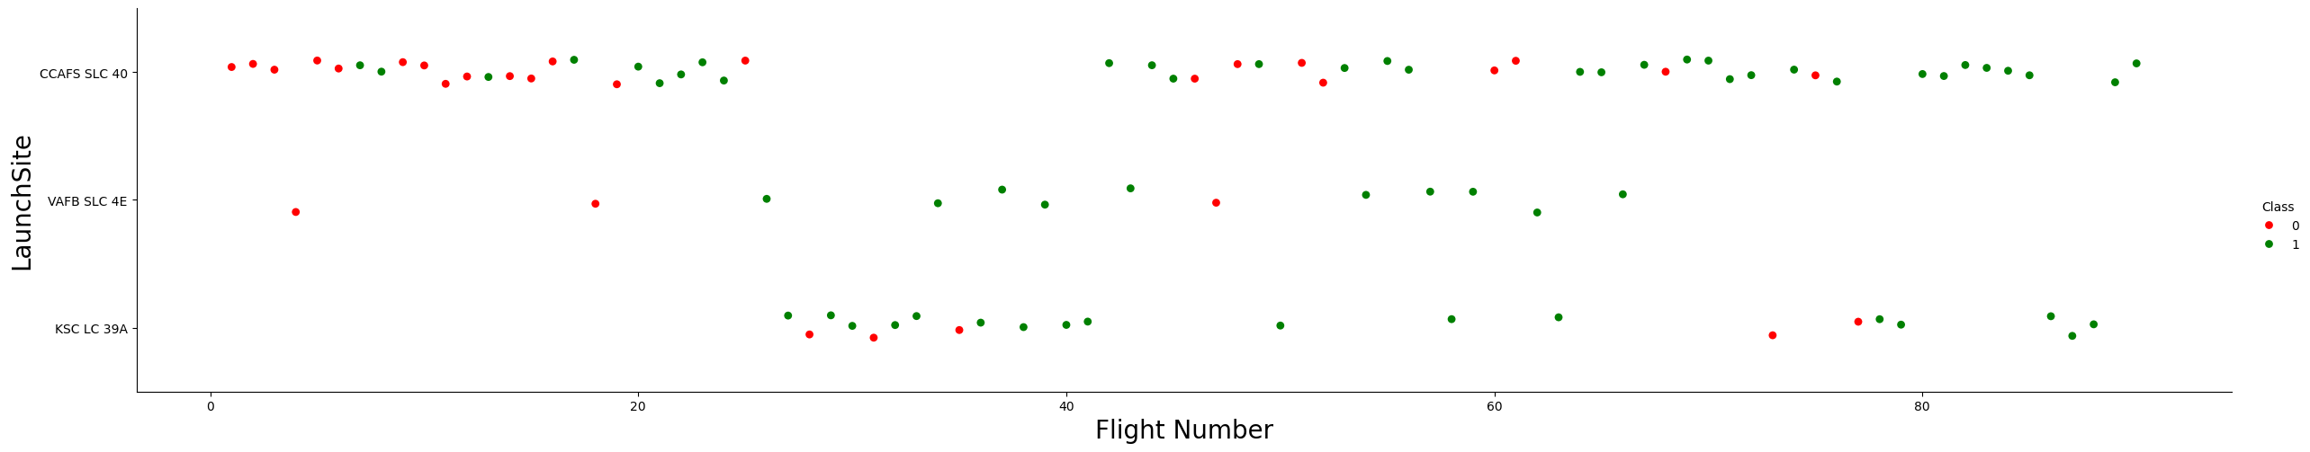
Flight Number vs. Launch Site
The launch site with the highest number of launches is CCAFS SLC 40
The launch site with the least number of launches is VAFB SLC 4E
As the flight number increases, the likelihood of success also increases

Slide 20
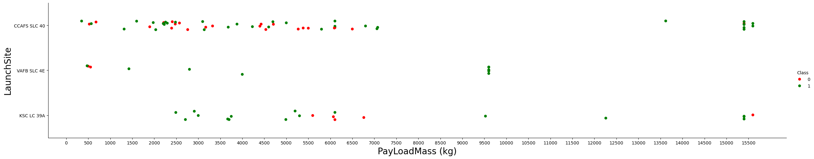
Payload vs. Launch Site
For the VAFB-SLC launch site there are no rockets launched for heavy payload mass (greater than 10000 kg)
KSC LC 39A has a 100% success rate for payload mass under 5500 kg
The likelihood of success is very high for heavier payload mass (>9000 kg)

Slide 21
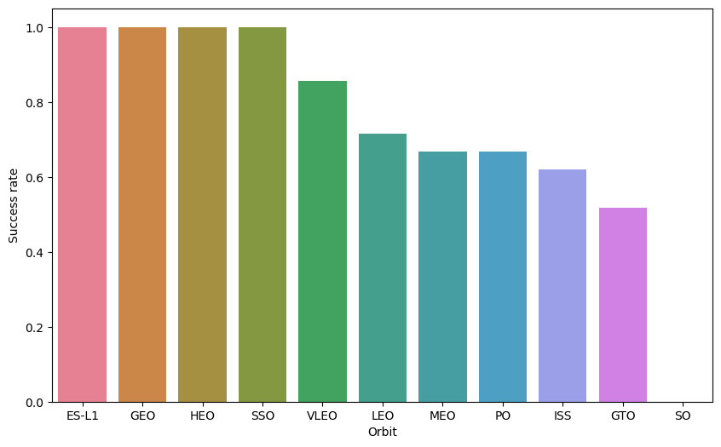
Success Rate vs. Orbit Type
ES-L1 (Lagrange Point 1): A point between the sun and the Earth where gravitational forces cancel out, allowing small objects to remain in equilibrium.
01
GEO (Geosynchronous Orbit): A circular orbit 35,786 kilometers above Earth's equator, following the direction of Earth's rotation.
02
HEO (Highly Elliptical Orbit): An elliptic orbit with high eccentricity, usually around Earth.
03
04
SSO (Sun-synchronous Orbit or SO): A nearly polar orbit around a planet, ensuring the satellite passes over any given point at the same local mean solar time.
ES-L1, GEO, HEO and SSO have a 100% success rate | SO has a 0% success rate

Slide 22
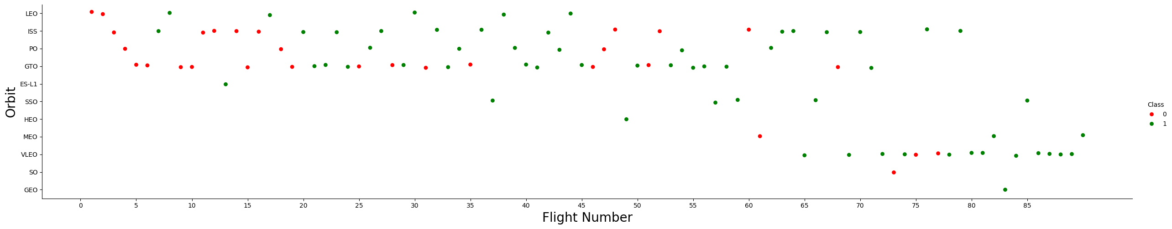
Flight Number vs. Orbit Type
In the LEO orbit the Success appears related to the number of flights
On the other hand, there doesn't seem to be a clear increase or decrease in success rate with increasing flight number
01
LEO (Low Earth Orbit): This orbit is at an altitude of 2,000 km or less, containing most manmade objects in outer space.

Slide 23
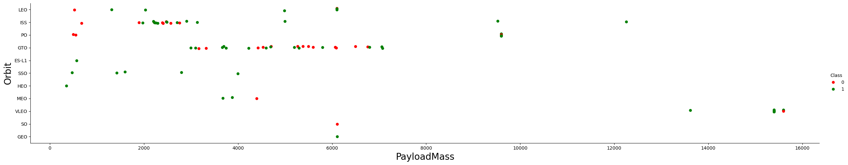
Payload vs. Orbit Type
Heavy payloads tend to have a higher success rate for landing, especially in PO, LEO and ISS
There doesn't seem to be a clear increase or decrease in success rate with increasing payload mass in GTO
The other orbits have too few launches to draw any conclusions

Slide 24
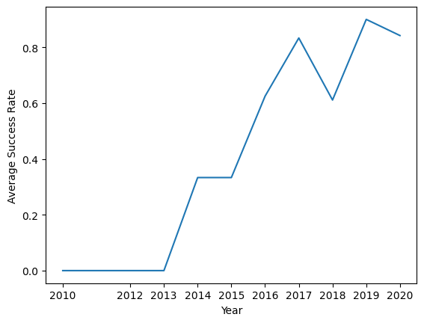
Launch Success Yearly Trend
The average success rate of Falcon 9 launches has been increasing steadily over time
There was a noticeable rise in success rates between 2013 and 2015, possibly due to technological advancements or improvements in manufacturing procedures.

Slide 25
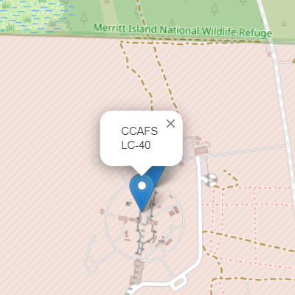
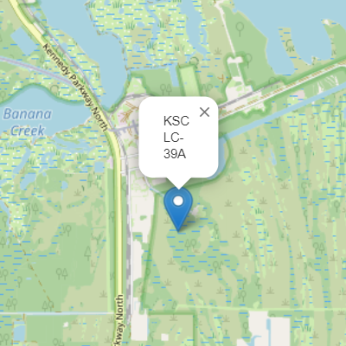
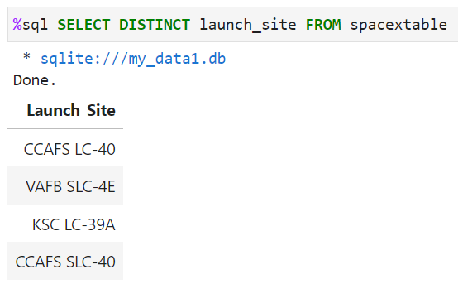
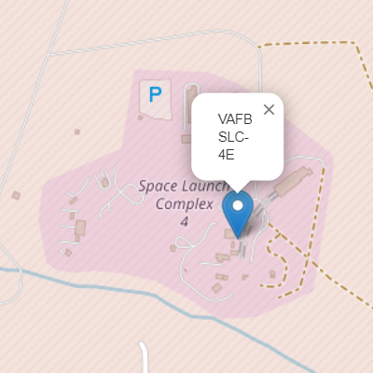
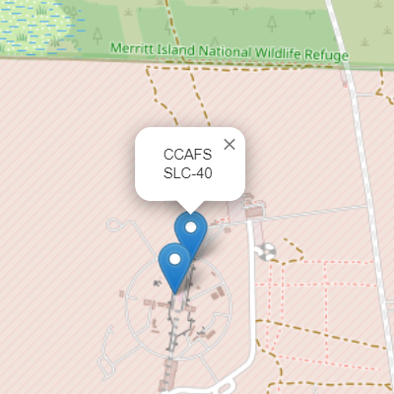
All Launch Site Names
Unique launch sites in the space mission

Slide 26
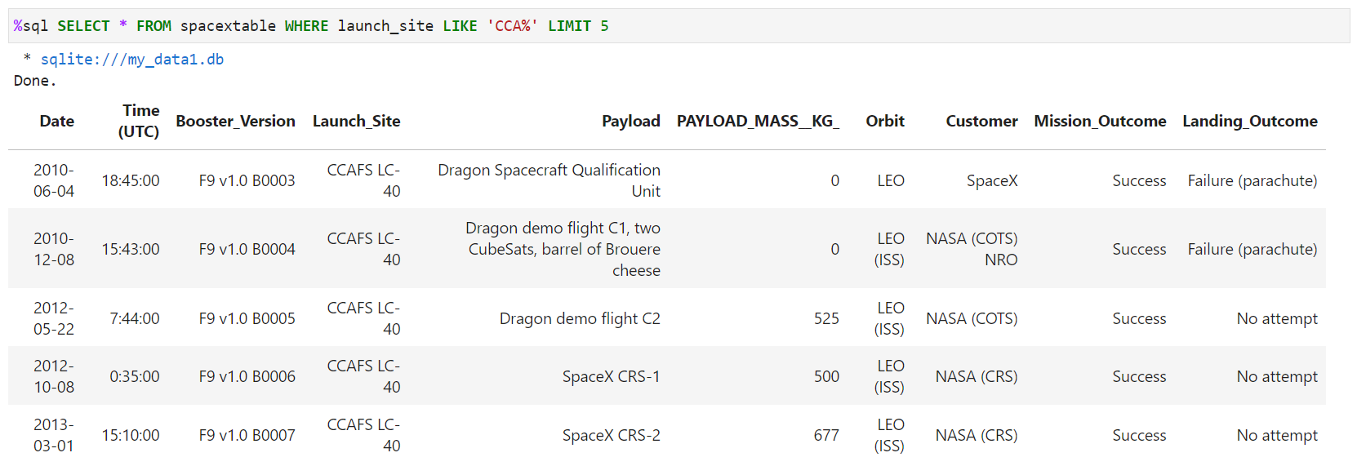
Launch Site Names Begin with 'CCA'
Five records where launch sites begin with the string 'CCA'

Slide 27
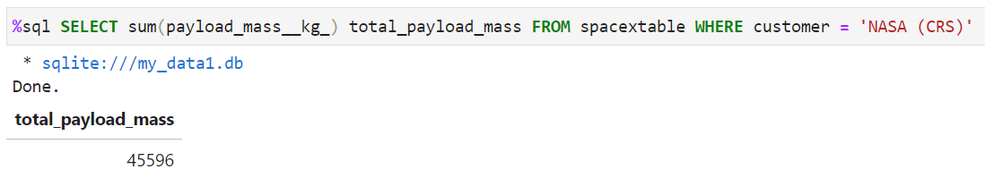
Total Payload Mass
Total payload mass carried by boosters launched by NASA (CRS)

Slide 28
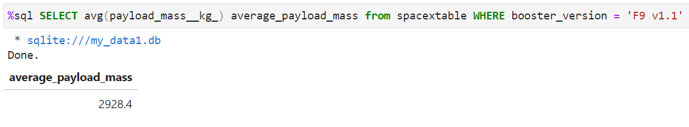
Average Payload Mass by F9 v1.1
Average payload mass carried by booster version F9 v1.1

Slide 29
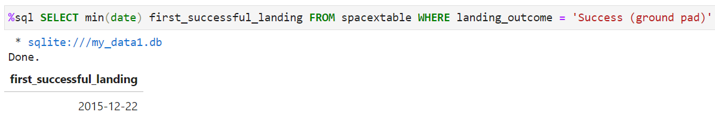

First Successful Ground Landing Date
Date of the first successful landing outcome in ground padC

Slide 30
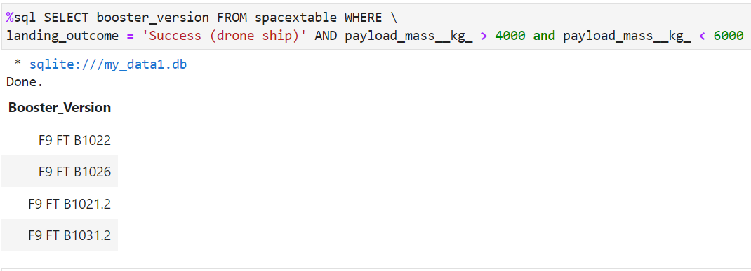
Successful Drone Ship Landing with Payload between 4000 and 6000
Names of the boosters which have success in drone ship and have payload mass greater than 4000 but less than 6000

Slide 31
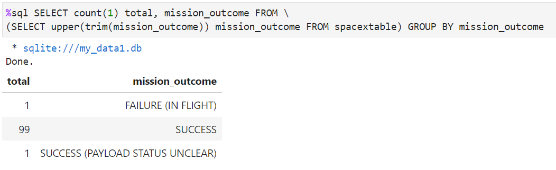
Total Number of Successful and Failure Mission Outcomes
Total number of successful and failure mission outcomes

Slide 32
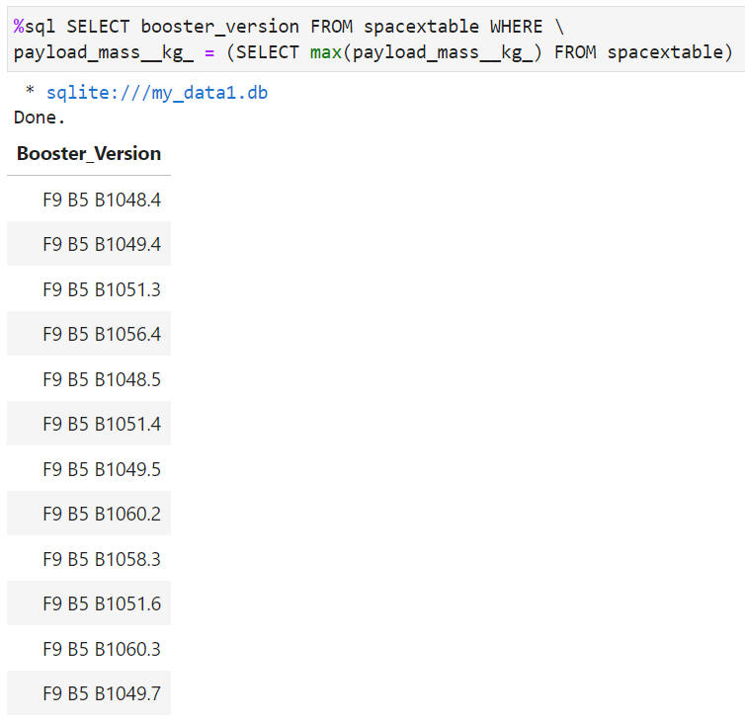
Boosters Carried Maximum Payload
Names of the booster_versions which have carried the maximum payload mass

Slide 33
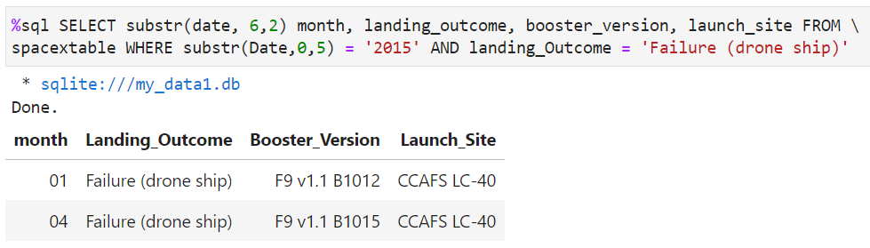
2015 Launch Records
Month, failure landing_outcomes in drone ship, booster version, and launch site for the months in year 2015

Slide 34
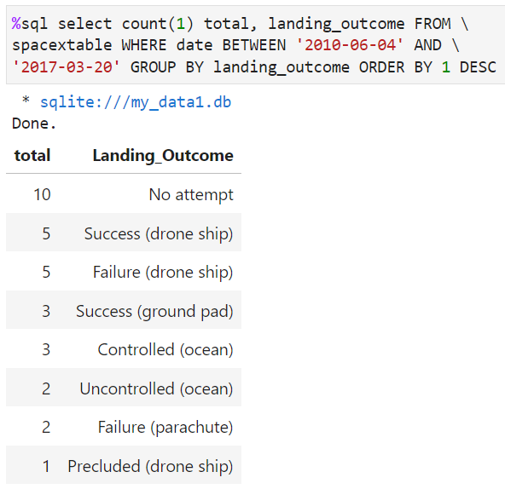
Rank Landing Outcomes Between 2010-06-04 and 2017-03-20
Count of landing outcomes between the date 2010-06-04 and 2017-03-20, in descending order

Slide 35

Section 3

Slide 36
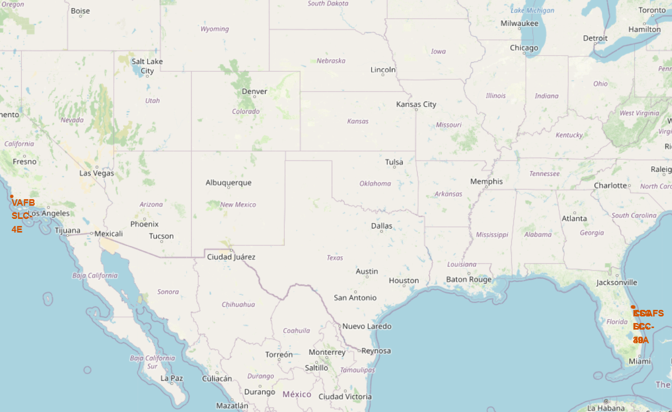
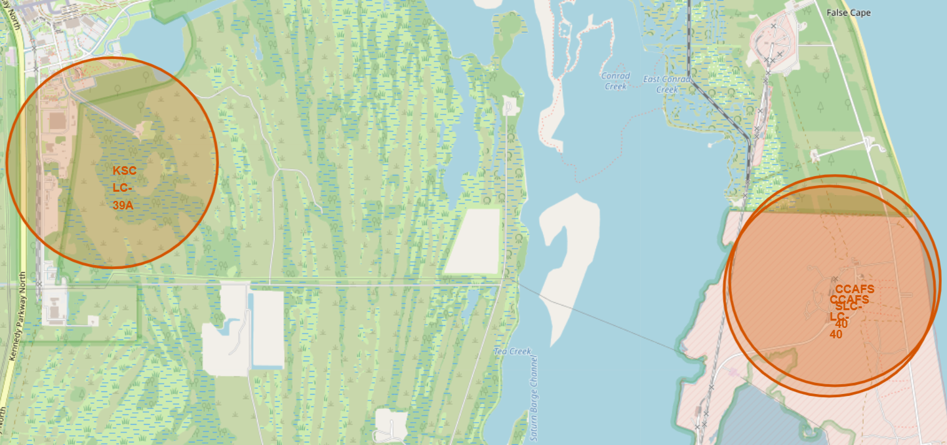
All Launch Sites
All launch sites are located near coastlines to provide flexibility for trajectory options and safety considerations

Slide 37
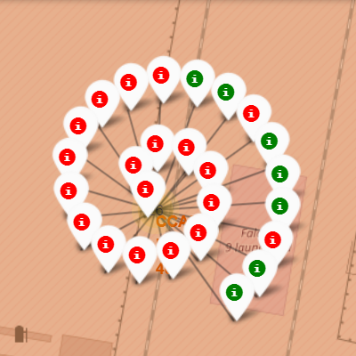
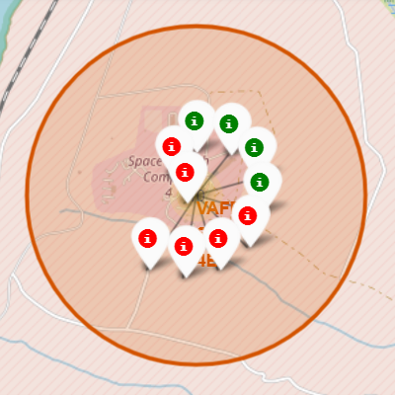
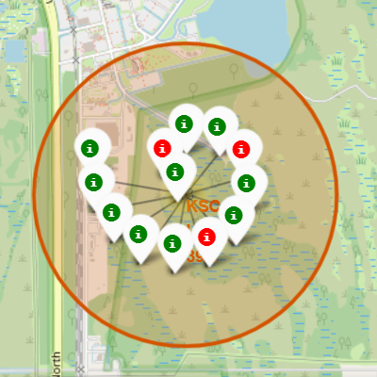
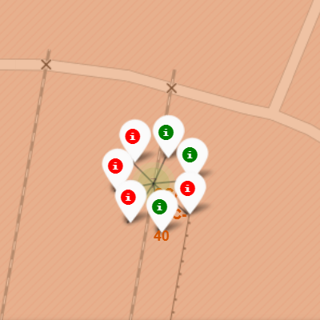
Launch Outcomes by Site
Successful launch
Failed launch
CCAFS LC-40
VAFB SLC-4E
KSC LC-39A
CCAFS SLC-40
The launch site with the highest number of launches is CCAFS LC 40, however, it has a high percentage of failed launches
KSC LC-39A has a very high success rate

Slide 38
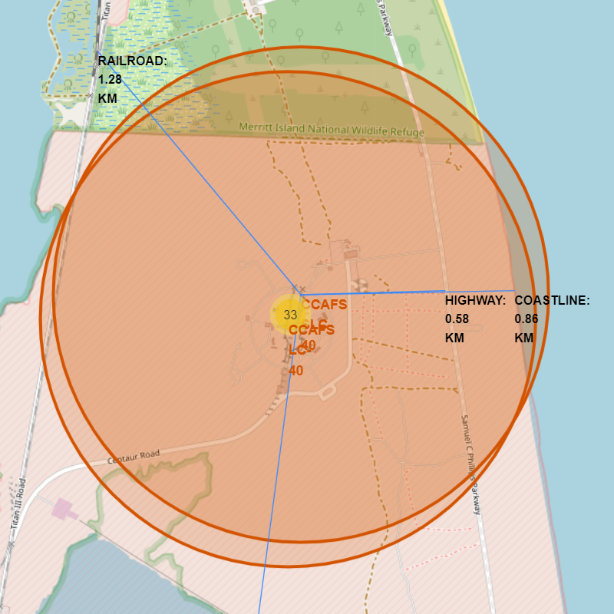
Distance Between CCAFS SLC 40 to its Proximities
CCAFS SLC 40 is situated in proximity to a coastline, a highway, and a railroad; however, it is not near inhabited areas

Slide 39

Section 4

Slide 40
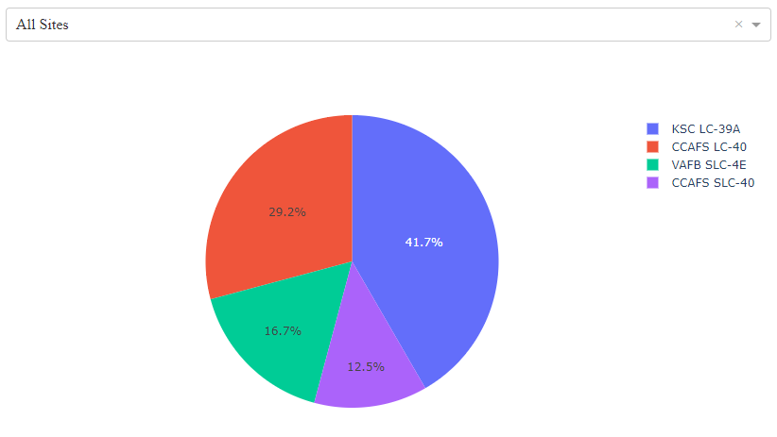
Launch Success Count – All Sites
KSC LC 39A is the launch site with the highest number of successful launches
Although CCAFS LC-40 has the highest number of launches among the launch sites, its success count is not particularly high
CCAFS SLC-40 has the lowest number of successful launches, but also the smallest number of launches.

Slide 41
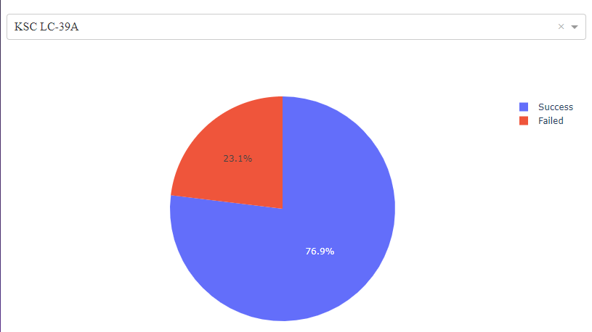
Highest Launch Success Rate
KSC LC 39A is the launch site with the highest success rate with 10 successful launches and 3 failed ones

Slide 42
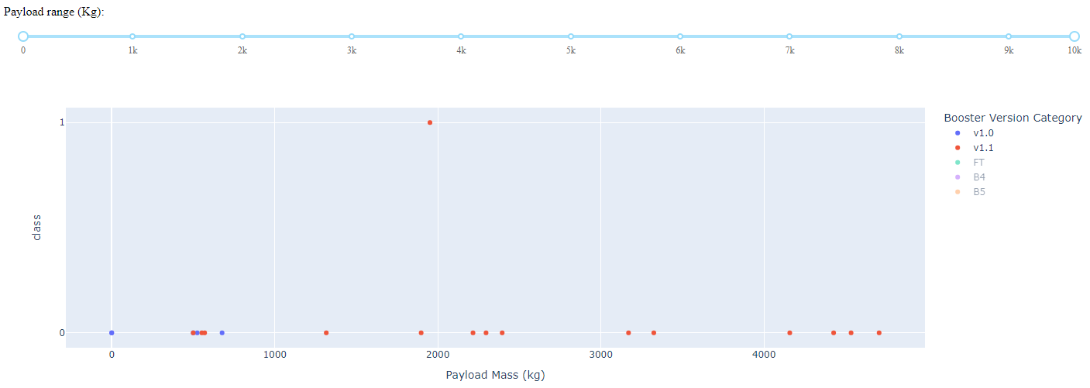
Lowest Launch Success Rate
Booster v1.0 has only failed launches, while booster v1.1 has only one successful launch

Slide 43
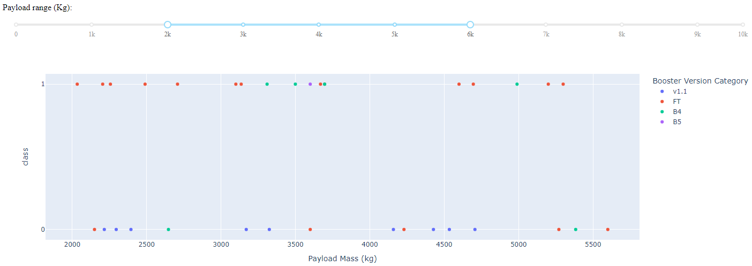
Highest Launch Success Rate
Payloads ranging between 2000 and 5500 have the highest launch success rate | FT boosters have the highest success rate
Most unsuccessful launches within this range are associated with v1.1 boosters, which only has one successful launch overall (not in this range)

Slide 44

Section 5

Slide 45
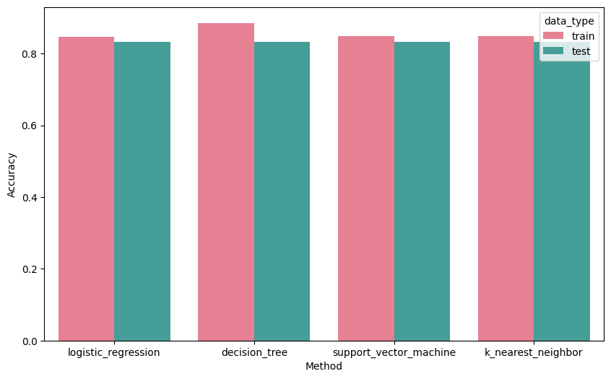
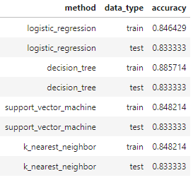
Classification Accuracy
All methods exhibited nearly identical performance, with the exception that the decision tree classifier slightly outperformed the others on training data

Slide 46
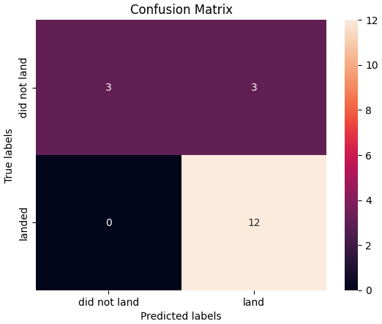
Confusion Matrix
True Positives: 3 False Positives: 3 False Negatives: 0 True Negatives: 12
While most results were accurate, the issue appears to lie in false positives. It is possible that expanding the dataset could lead to improved accuracy

Slide 47
Conclusions
All launch sites for Falcon 9 are near a coastline
The best launch site in terms of the quantity of launches vs success rate is KSC LC-39A
Payload mass ranging between 2000 and 5500 have the highest launch success rate
FT booster version category has the highest launch success rate
Logistic regression, decision tree, support vector machine, and k-nearest neighbors methods exhibit nearly identical performance in predicting the successful first stage landing of the Falcon 9. The decision tree classifier, however, shows a slightly better performance on the training data.
The likelihood of launch success shows an upward trend both over the years and as the flight number increases

Slide 48


